Slide 1
Advanced Systems Analysis and Design Constructing the Sprint Plan SOFT 30121 L19 Presented By Nigel King ACMA CGMA PCM Nigel.King@ntu.ac.uk

Slide 2

Constructing the Sprint Plan

Slide 3
Introduction
This section of the module is to ensure that you are all working well as a group. The theory piece is behind us. This is the practical stuff of generating velocity, developing trust and working practices to hold each other accountable as a team. It will be liberally sprinkled with anecdotes and observations of what worked well and what did not in my working life.

Slide 4
The Big Picture
Constructing your sprint plan
Defining your teams’ definition of “done”.
Conducting Scrum Meetings
Conducting Reviews

Slide 5
Constructing the sprint plan
What is a sprint plan.
We all now know what a sprint is. We know that the reason for agile practices is that business people are generally pretty poor at expressing requirements, but will tell you very quickly if they are unhappy. With a bit of coaxing they will also tell you when they are delighted. This is always done best by demonstrating.
However, there is an inescapable truth, that the project was sponsored by somebody who is expecting a set of features. Whatever we think of “traditional” project planning and execution techniques, we need to show that we have a plan to deliver the set of features.
It is OK to change course if the product owner realizes they missed a key feature. It is not OK to loose sight of harbour without charts, maps and sextant.
At this point, you should have the set of features from your specification and some sense of sizing: T-Shirt sizing, Man Days, Story Points.
The mission is to come up with how those features fall into a set of sprints, complete to our definition of done, by the hand in date.
We should have agreed as a team what is in the first sprint.

Slide 6
Backlogs
Product Backlog
Our product owner is responsible for telling us the order of priority of the features, as well as enhancements and bugs, that are going into this release.
This is our first release so it is our minimum viable product.
The distinction between features and enhancements is generally one of scale. Customers will always be requesting new capabilities in your products. Some might be quite small. You would generally call these enhancements. It is unlikely that you would charge separately for an enhancement. Some might be quite big. You would generally call these features. You should try and get customers to pay for new features. It is great to build incredible software. It is also nice to eat.
Bugs are where software is not working according to specification. Typically software must function in accordance with its published documentation. Good product managers will think every nuance is a bug. You need these people. You need their eyes and energy and instincts. However, everything you fix introduces the risk that you destabilize something else. You need to apply good engineering judgement and good business judgement. It is much better to release stable software, predictably on cadence. Plan capacity for bug fixes from prior releases in upcoming release plans. That said an escaped bug is truly embarrassing and we should hang our heads in shame when a customer finds one.

Slide 7
Backlogs
Product Backlog
Tasks
Size the planning items in the backlog
Rank the items in the backlog

Slide 8
Backlogs
Product Backlog - Size the planning items in the backlog
Methodology
T-Shirt Sizing
Man Days
T-Shirt Sizing
My preference is for T-Shirt sizing. I can get a set of people with very different skill sets and backgrounds to be able to understand each other and challenge each other on T-Shirt sizing.
T-Shirt sizing is a relative scaling process. It is more observable. This is bigger than that.
Man Days
Engineers tend to feel that they are being managed too closely if you try and get man days out of them, (and their estimates will tend to be padded).
Conversion Scales
At the end of the day, you have to present a plan that shows you can get the work done on time. You will have to convert to man days.

Slide 9
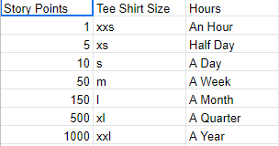
Backlogs
Product Backlog - Size the planning items in the backlog
Conversion Scales
This is my very rough conversion scale. It is good enough to start a conversation.

Slide 10
Backlogs
Product Backlog - Size the planning items in the backlog. Time Box. 10 Minutes.
Team exercise
Size the following 5 features
Modifying a Gender field to include “Prefer not to Say”
Adding SMS notification capability to scheduled prescription pickups.
Adding a new person type for Nurse.
Automatically generating scheduled prescription pickups.
Sizes
XS
S
M
L
XL

Slide 11
Backlogs
Product Backlog
Our product owner is responsible for telling us the order of priority of the features, as well as enhancements and bugs, that are going into this release.
This is our first release so it is our minimum viable product.

Slide 12
Backlogs
Product Backlog – Enhancements and Features
The distinction between features and enhancements is generally one of scale. Customers will always be requesting new capabilities in your products. Some might be quite small. You would generally call these enhancements. It is unlikely that you would charge separately for an enhancement. Some might be quite big. You would generally call these features. You should try and get customers to pay for new features. It is great to build incredible software. It is also nice to eat.

Slide 13
Backlogs
Product Backlog - Bugs
Bugs are where software is not working according to specification. Typically software must function in accordance with its published documentation.
Good product managers will think every nuance is a bug. You need these people. You need their eyes and energy and instincts. However, everything you fix introduces the risk that you destabilize something else. You need to apply good engineering judgement and good business judgement. It is much better to release stable software, predictably on cadence. Plan capacity for bug fixes from prior releases in upcoming release plans.
As release dates approach, executive VP’s (guys and gals that report to the CEO of a 40 billion dollar company), review “Must Have” bug fixes in the current release. If you have a “must have” bug fix, your life is not happy.
If a customer finds an escaped bug, we should hang our heads

Slide 14
Backlogs
Product Backlog – Scoring and Ranking
The product owner has is accountable for the success of the product features in the market.
The engineering team is responsible for product quality and timely delivery.
So how does the product owner decide priority? If you let one customer dictate priority, you are not destined for long term commercial success.
There are a number of methodologies you can use with a set of customers / stakeholders.
Likert Scale rating of features
Very Important
Important
Neither Important or Unimportant
Unimportant
Irrelevant
Pairwise comparison of features
Force ranking a list by expressing preference in each pair
Budget allocation of features
Give customers 100 points to allocate.

Slide 15
Backlogs
Product Backlog – Scoring and Ranking. Time Box. 10 Minutes.
Team exercise
Score the following 5 features
Modifying a Gender field to include “Prefer not to Say”
Adding SMS notification capability to scheduled prescription pickups.
Adding a new person type for Nurse.
Automatically generating scheduled prescription pickups.
Automatically send blood test requests for overdue bloodwork
You each have 100 points
Allocate your 100 points
Add for all participants
Rank by aggregate score

Slide 16
Backlogs
Sprint Backlog
The sprint backlog is what the scrum team commits to getting done in the current sprint. At a sprint planning meeting at the start of the sprint cycle you will generally take the highest priority items from the backlog and move those into the spring backlog until you have consumed the expected velocity of the team.
The team will generally turn features into user stories. User stories force good structure and testability into the requirement with minimum detail.
Sprint velocity is generally measured in story points. Story Points measure complexity.

Slide 17
Backlogs
Sprint Backlog
However, there are some caveats in our first sprint.
We have no history on which to base our velocity assumptions.
Our engineering priority is to establish the architecture. You are the artist, but your first step is to pin the canvas to the frame. Not necessarily to apply paint just yet.
You need some small nugget of value that is meaningful for you product owner.
What is most important is predictability. Do something small that tests the architecture and makes the team believable to the product owner.

Slide 18
Backlogs
Sprint Backlog
There are some caveats in all sprints.
There is lots of uncertainty. Different people may regard tasks as more or less complex.
Planning poker is a great way to get consensus of at least surface disagreement on assumptions of complexity.
Adding a “Discover” task is a good way to surface uncertainty. Better than making planning items very long. For example, if a simple task has to be done in an unfamiliar tool.
Some tasks planning items may need to be decomposed before part of them can be absorbed into a sprint.

Slide 19
Backlogs
Sprint Backlog – Planning Poker. Time Box 8 Minutes.
Team exercise
Story Point the following 5 stories
Modifying a Gender field to include “Prefer not to Say”
Adding SMS notification capability to scheduled prescription pickups.
Adding a new person type for Nurse.
Automatically generating scheduled prescription pickups.
Automatically send blood test requests for overdue bloodwork
Use Fibonacci Scale
1, 2, 3, 5, 8, 13, 21, 34
If all estimators selected the same value, that is the estimate. If there are differences, the high and the low estimator should explain their reasoning. The team should then all re-estimate.

Slide 20
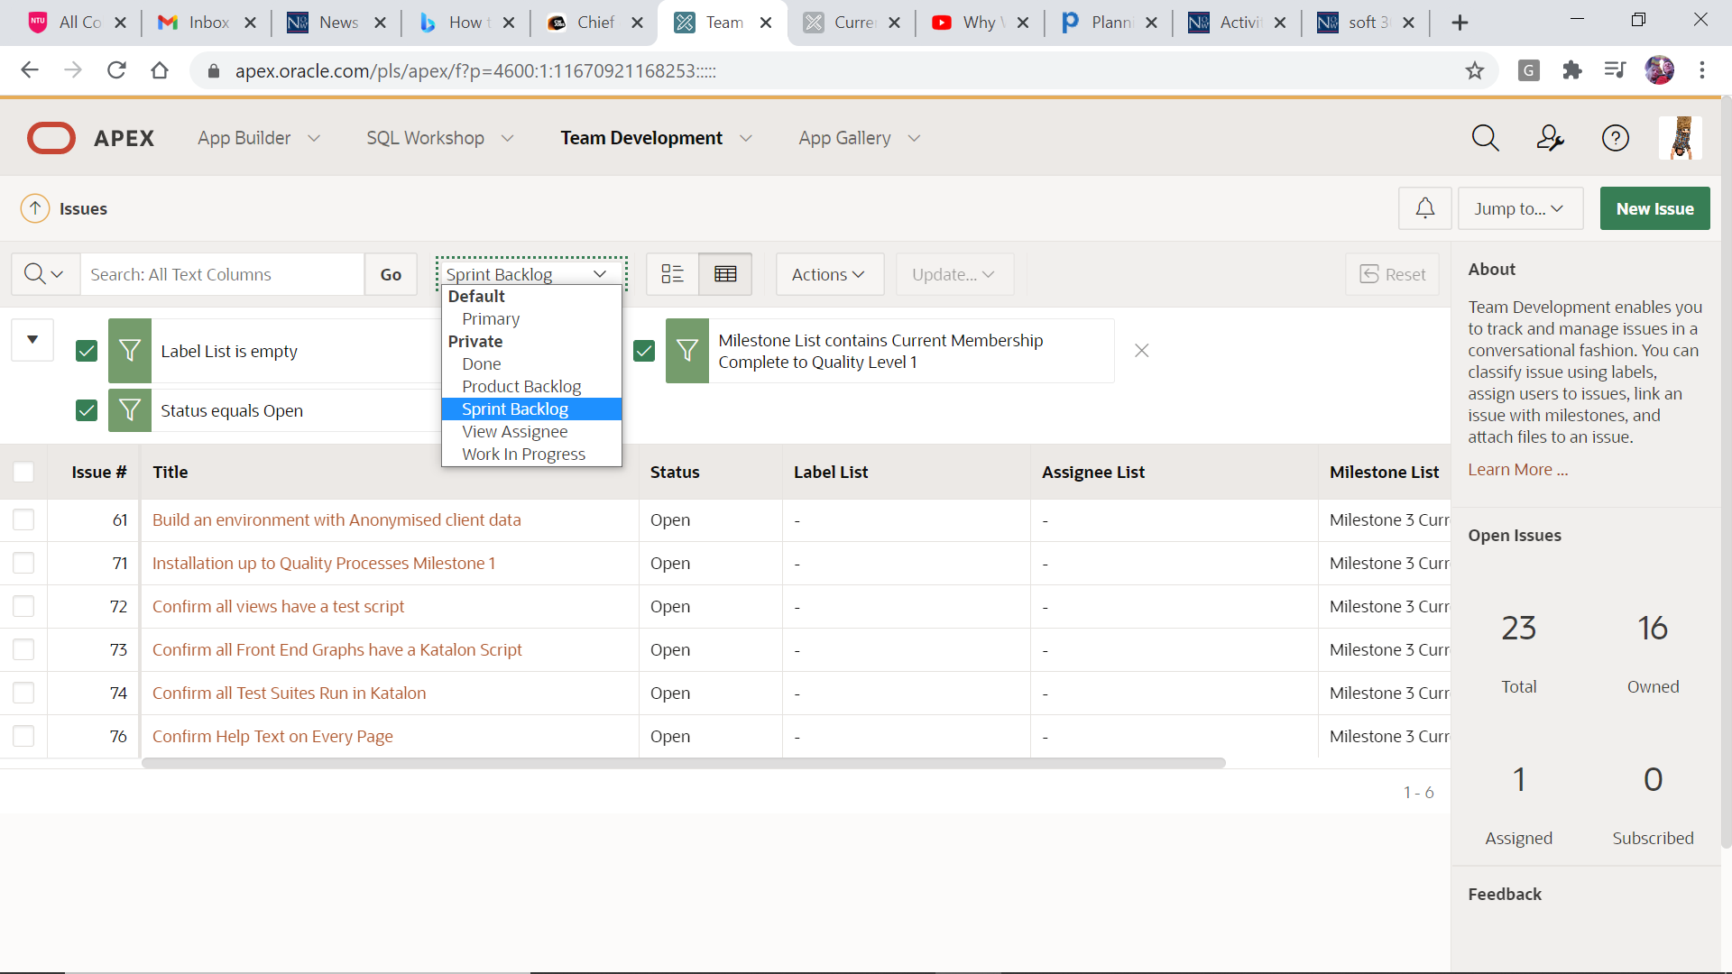
Real World Example

Slide 21
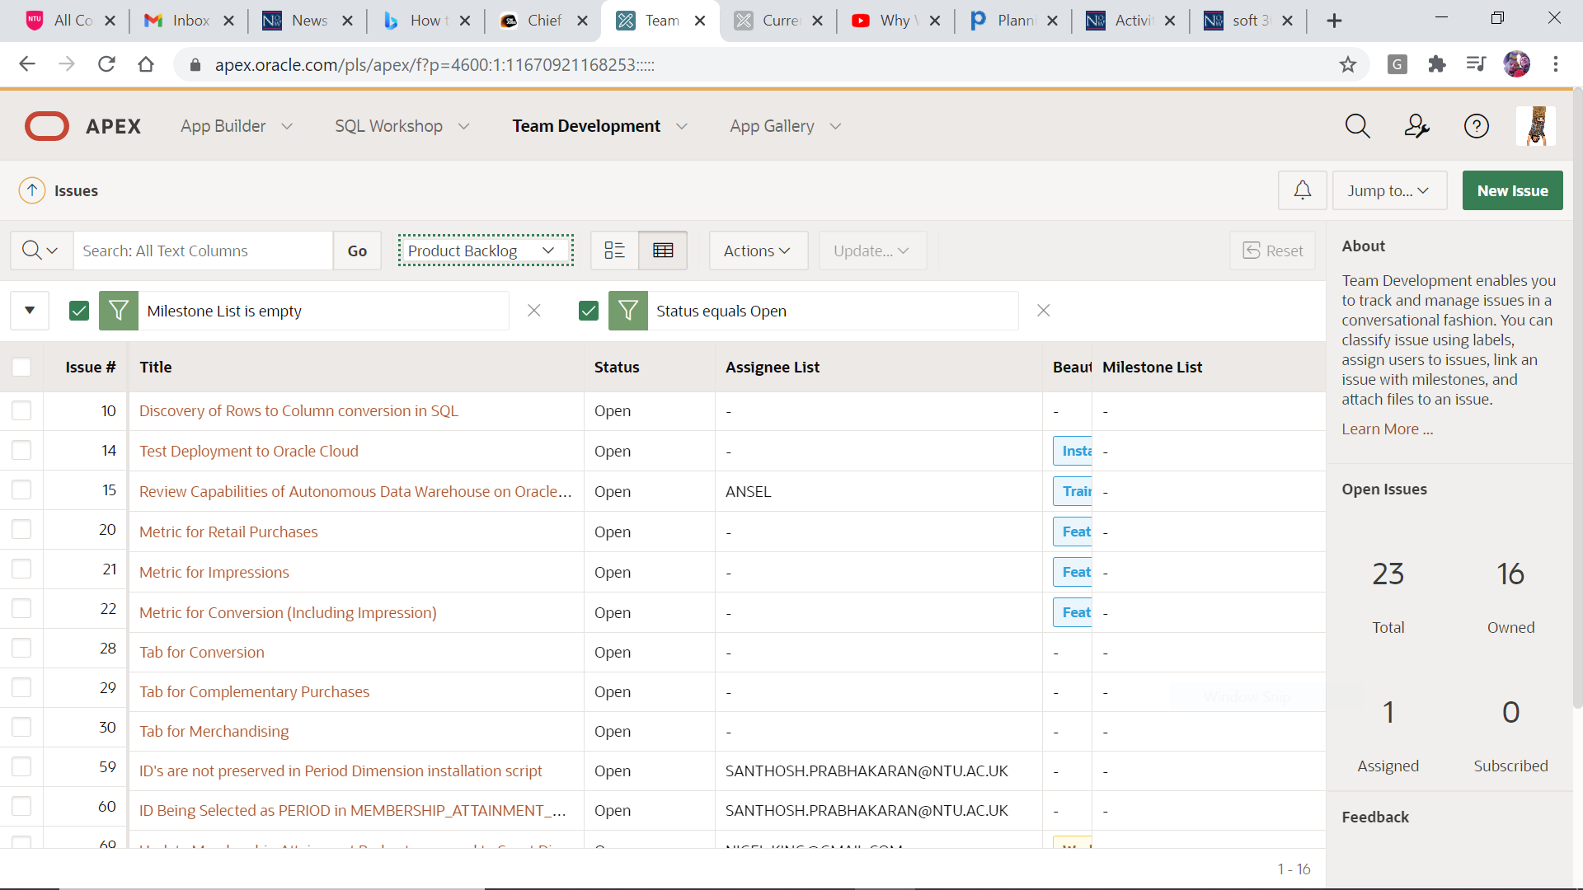
Real World Example

Slide 22
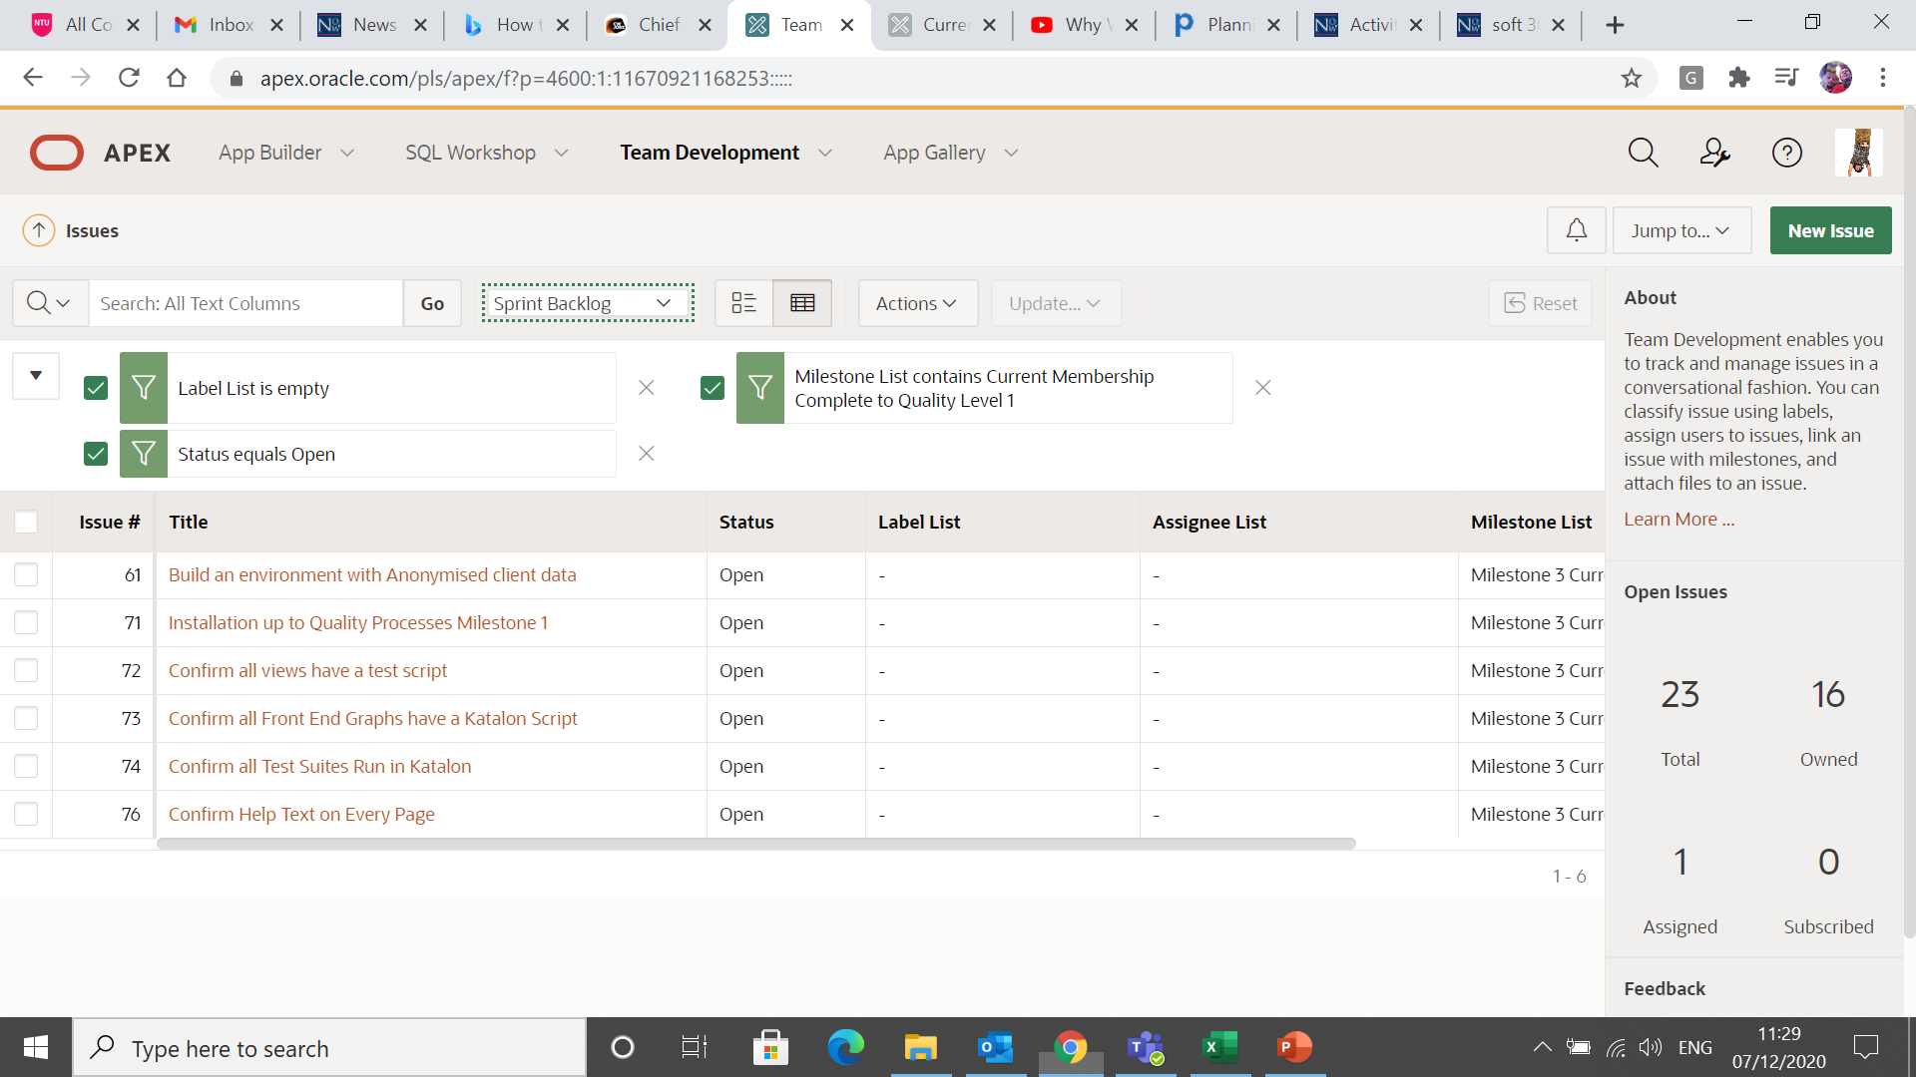
Real World Example

Slide 23
Next Lecture
Defining your teams’ definition of “done”.

